Slide 1




BaaS and kinvey.com
Creating Cloud-Based REST Services Backend
SoftUni Team
Technical Trainers
Software University
http://softuni.bg

Slide 2


Table of Contents
Cloud Overview: IaaS, PaaS, SaaS, BaaS
Backend-as-a-Service (BaaS) Overview
kinvey.com
Accessing REST Services from JavaScript

Slide 3

What is a Cloud?
IaaS, PaaS, SaaS and BaaS Models

Slide 4
Understanging the "Cloud"
54% claim that they have never used Cloud
95% claim that they have used Cloud without knowing it
51% believe that cloudy weather affects the Cloud computing
29% think that Cloud technology has something in common with the weather
16% are correct that Cloud is a place for storage, access and sharing information

Slide 5
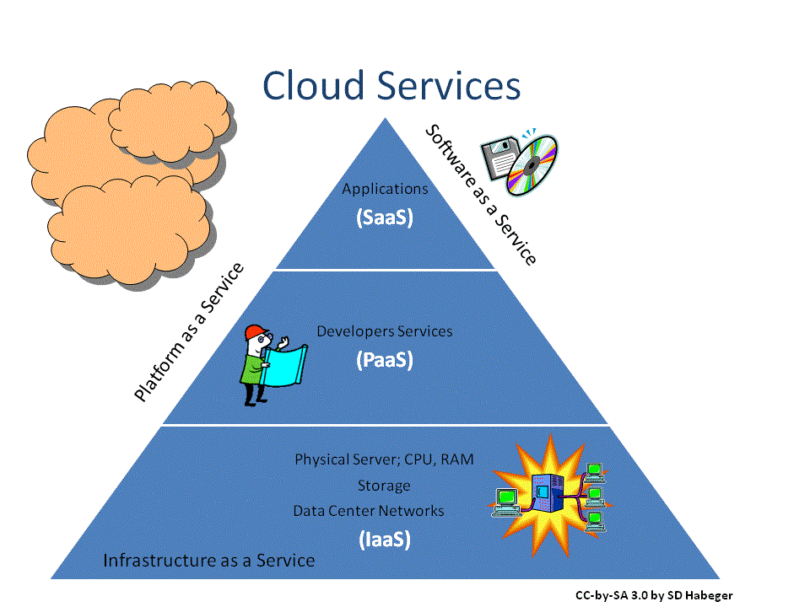
Cloud service types
IaaS
Renting virtual machines
E.g. Live Smart Solutions
PaaS
Full software development kit
E.g. Heroku
SaaS
Software access online
E.g. Wordpress

Slide 6

What is BaaS (MBaaS)?
BaaS Clouds. Typical BaaS Services

Slide 7
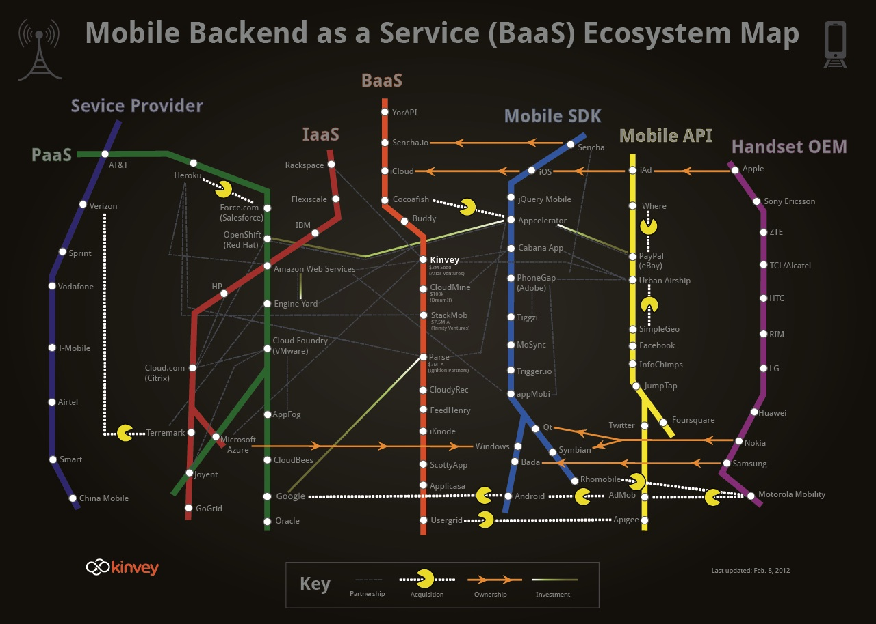
What is BaaS?
A service providing:
Connection with backend cloud storage
Application programing interface (API)
Set of tools:
User management
Push notifications
Social network integration

Slide 8
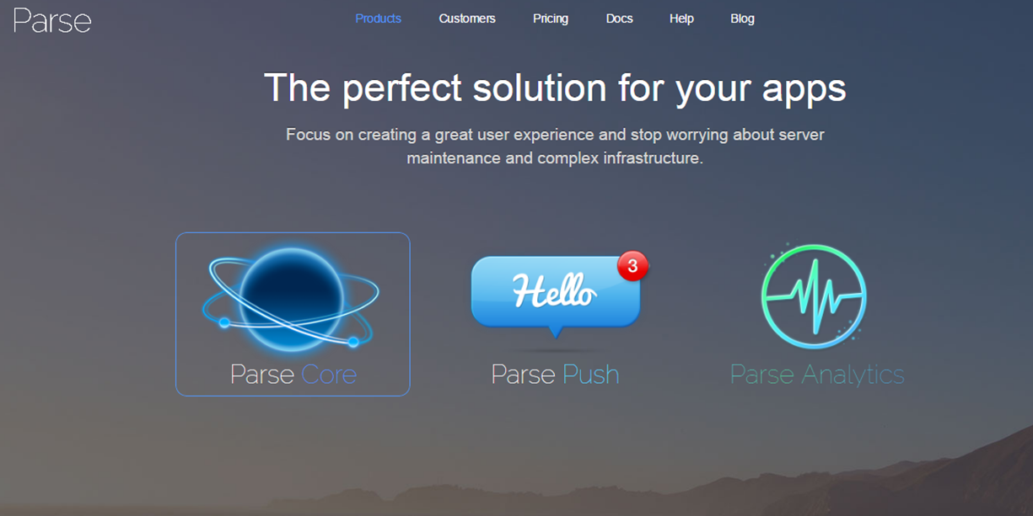
Kinvey.com
Public BaaS Cloud

Slide 9

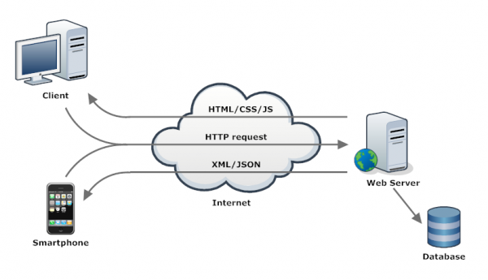

Accessing REST Services from JavaScript and jQuery

Slide 10









Web Storage and Cookies
https://softuni.bg/courses/javascript-applications/

Slide 11
License
This course (slides, examples, demos, videos, homework, etc.) is licensed under the "Creative Commons Attribution-NonCommercial-ShareAlike 4.0 International" license
Attribution: this work may contain portions from
"JavaScript Applications" course by Telerik Academy under CC-BY-NC-SA license

Slide 12





Free Trainings @ Software University
Software University Foundation – softuni.org
Software University – High-Quality Education, Profession and Job for Software Developers
softuni.bg
Software University @ Facebook
facebook.com/SoftwareUniversity
Software University @ YouTube
youtube.com/SoftwareUniversity
Software University Forums – forum.softuni.bg

